Slide 1
DATABASE PHASE 5
GROUP MEMBER:
LIURUOYANG
PRANTO ANIK ISLAM
KAHLAN SULTAN
BUGUOSHUN

Slide 2
MENU
1
Relational Database Schemas
Queries with Detailed Explanations
2
3
User Manual for Hospital Management System

Slide 3
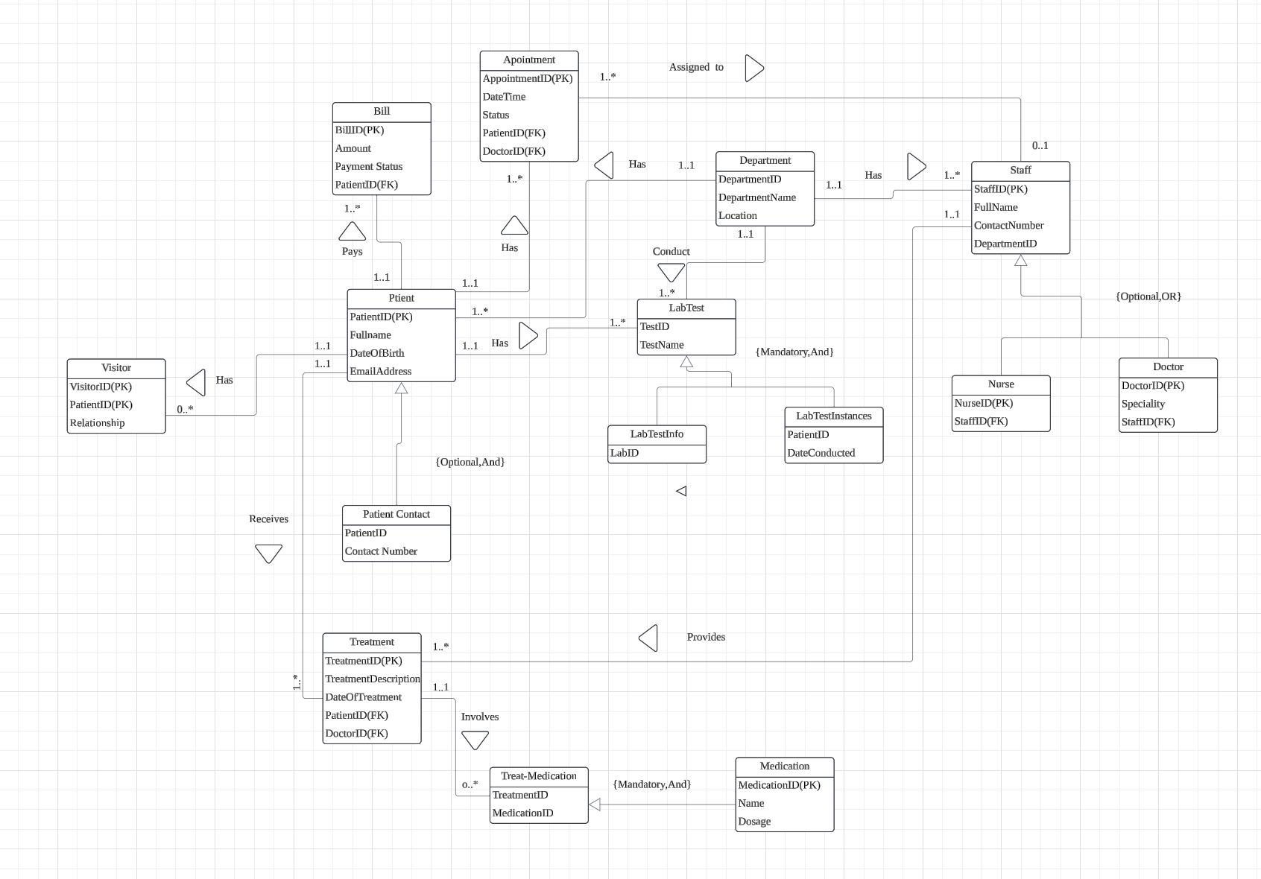
Logical ERD

Slide 4
1.Relational Database Schemas
1. Patient Table
2. Patient Contact Table
3. Visitor Table
4. Bill Table
5. LabTest Table
6. LabTestInfo Table 7. LabTestInstances Table
8. Department Table 9. Staff Table 10. Doctor Table
11. Nurse Table
12. Appointment Table
13. Treatment Table
14. Medication Table
15.Treat-Medication Table

Slide 5
1.Relational Database Schemas
Patient Purpose: Stores patient details. Attributes: PatientID, FullName, DateOfBirth,
EmailAddress.
PatientContact Purpose: Stores patient contact numbers. Attributes: PatientID, ContactNumber.
Visitor Purpose: Tracks visitors associated with patients. Attributes: VisitorID, PatientID, Relationship.
Bill Purpose: Manages billing information. Attributes: BillID, Amount, PaymentStatus, PatientID.
LabTest Purpose: Lists types of lab tests. Attributes: TestID, TestName.
LabTestInfo Purpose: Provides additional details about lab tests. Attributes: LabID, TestID.
LabTestInstances Purpose: Records lab tests conducted for patients. Attributes: TestID, PatientID, DateConducted.
Department Purpose: Defines hospital departments. Attributes: DepartmentID, DepartmentName, Location.

Slide 6
Staff Purpose: Stores information about hospital staff. Attributes: StaffID, FullName, ContactNumber,
DepartmentID.
Doctor Purpose: Tracks doctor details and specialties. Attributes: DoctorID, Specialty, StaffID.
Nurse Purpose: Tracks nurse details. Attributes: NurseID, StaffID.
Appointment Purpose: Manages patient appointments with doctors. Attributes: AppointmentID, DateTime, Status,
PatientID, DoctorID.
Treatment Purpose: Records treatments provided to patients. Attributes: TreatmentID, TreatmentDescription,
DateOfTreatment, PatientID, DoctorID.
Medication Purpose: Lists medications available. Attributes: MedicationID, Name, Dosage.
TreatMedication Purpose: Links treatments to medications used. Attributes: TreatmentID, MedicationID.

Slide 7
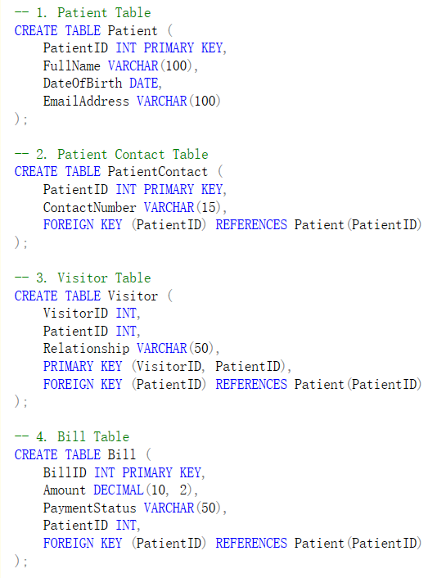
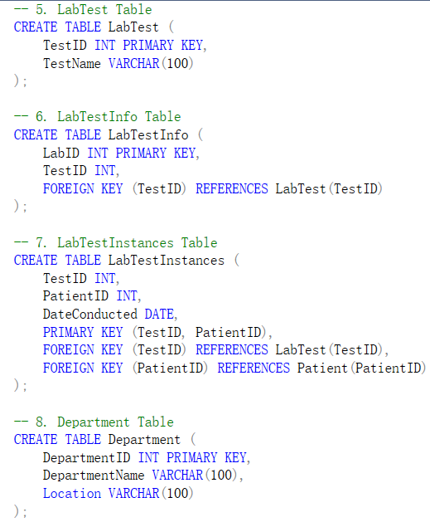
Building the database
We used SQL Server to implement this

Slide 8
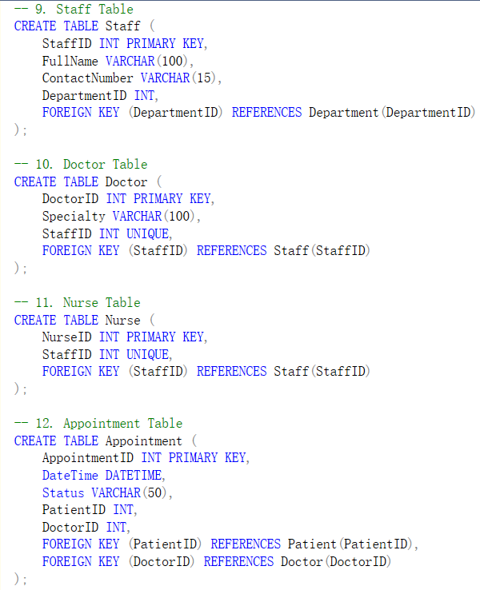
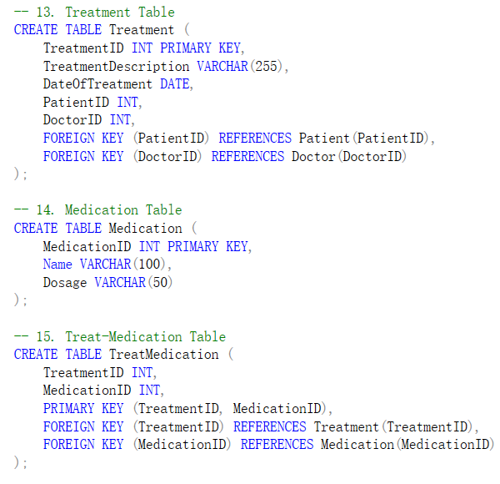

Slide 9
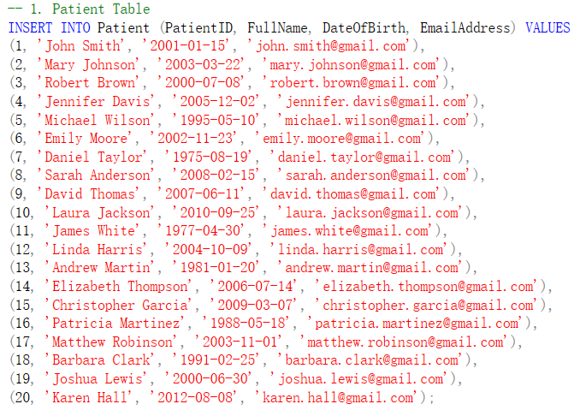
Inserting Data
We inserted 20 rows to each table

Slide 10
Basic Queries Aggregate and Statistical Queries Join Queries Conditional and Advanced Queries
Queries

Slide 11
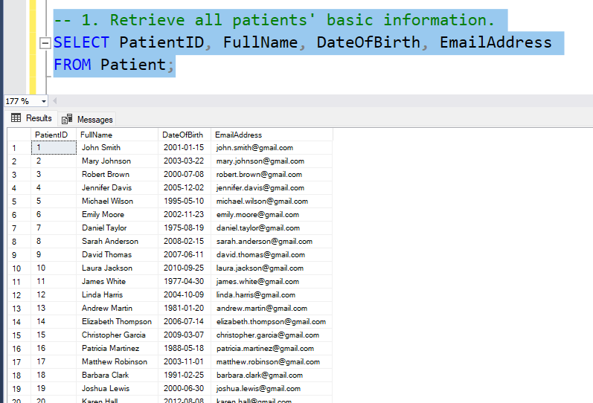
2.Queries with Detailed Explanations1.Retrieve all 1.Retrieve all patients' basic information. oFunction: Displays basic details for all patients, including ID, name, date of birth, and email address. oPurpose: Provides a quick overview of patient records.

Slide 12
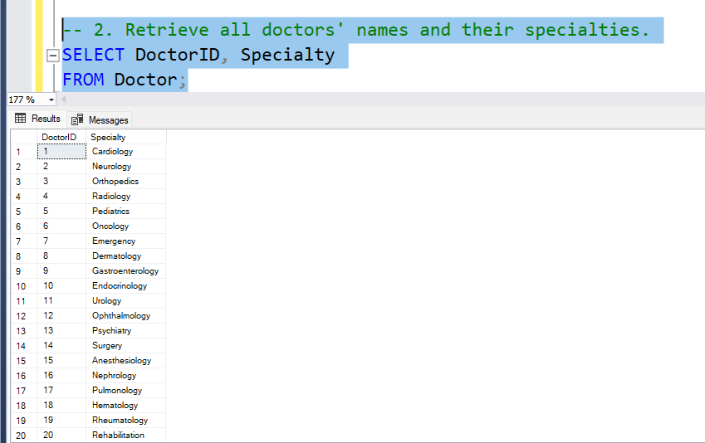
2.Retrieve all doctors' names and their specialties.
oFunction: Shows the IDs and specialties of all doctors.
oPurpose: Understands the distribution of medical specialties in the hospital.

Slide 13
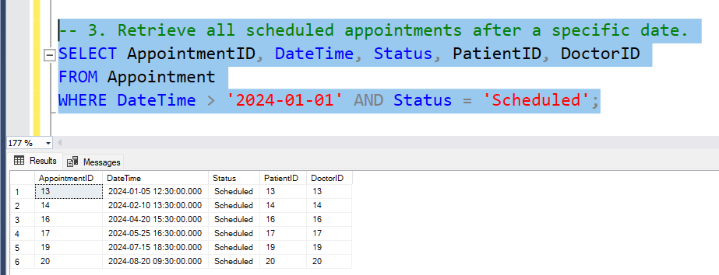
3.Retrieve all scheduled appointments after a specific date.
oFunction: Lists appointments scheduled after a specific date, including appointment ID, time, status, patient, and doctor details.
oPurpose: Tracks upcoming appointments.

Slide 14
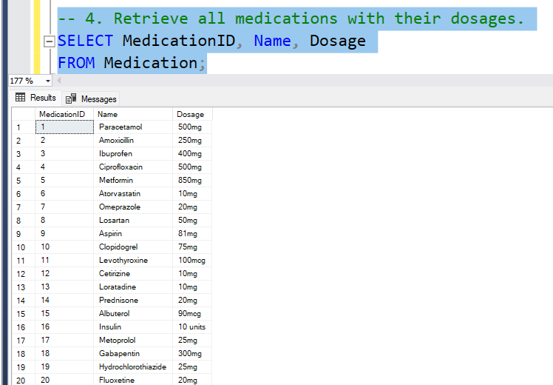
4. Retrieve all medications with their dosages
oFunction: Lists all medications and their dosages.
oPurpose: Displays a catalog of available medications.

Slide 15
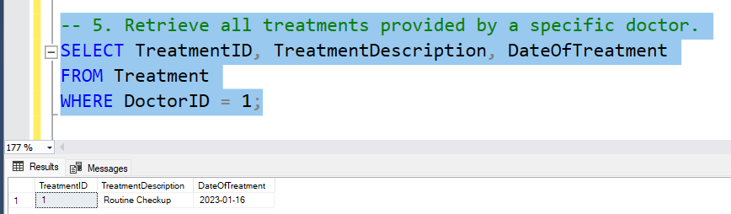
5. Retrieve all treatments provided by a specific doctor.
oFunction: Lists treatments conducted by a specific doctor (DoctorID = 1), including treatment description and date.
oPurpose: Tracks the treatment history of an individual doctor.

Slide 16
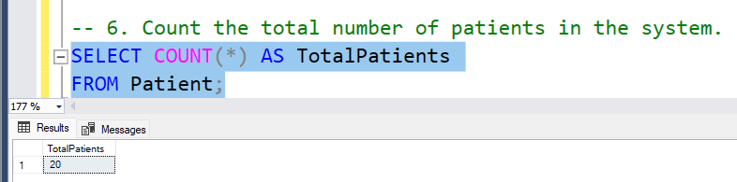
6. Count the total number of patients in the system.
oFunction: Counts the number of appointments completed by each doctor.
oPurpose: Analyzes doctor workload and completion rates.

Slide 17
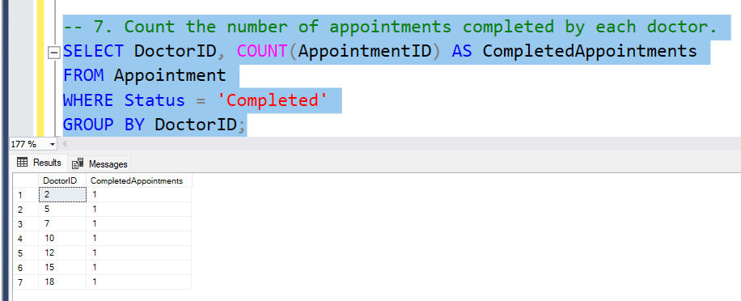
7. Count the number of appointments completed by each doctor.
oFunction: Counts the number of appointments completed by each doctor.
oPurpose: Analyzes doctor workload and completion rates..

Slide 18
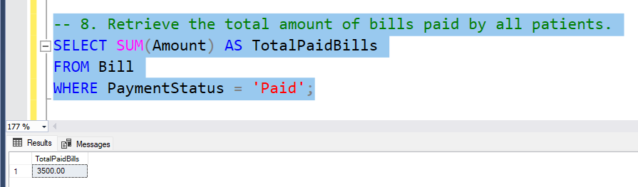
8. Retrieve the total amount of bills paid by all patients.
oFunction: Calculates the total amount of all paid bills.
oPurpose: Tracks total hospital revenue from paid bills.

Slide 19
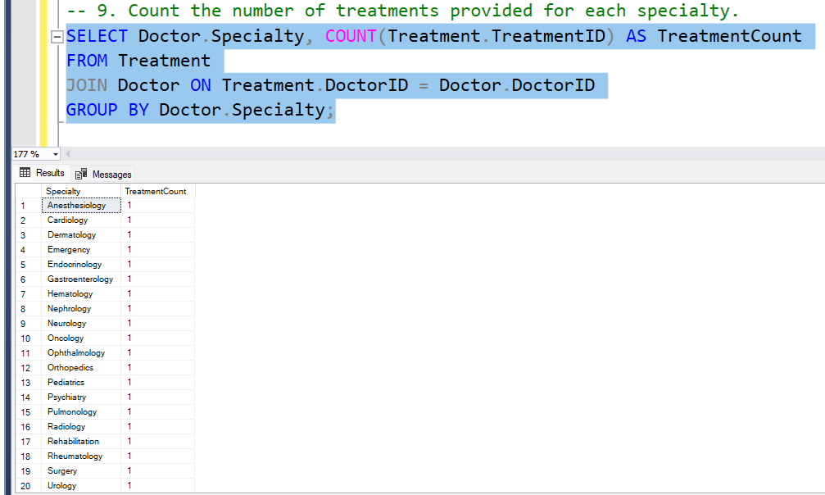
9. Count the number of treatments provided for each specialty.
oFunction: Counts the treatments provided, grouped by doctor specialty.
oPurpose: Evaluates the workload of each department or specialty.

Slide 20
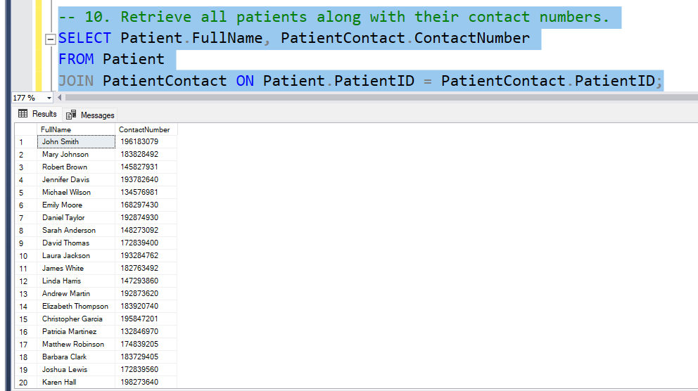
10.Retrieve all patients along with their contact numbers.
oFunction: Lists all patients with their contact numbers.
oPurpose: Quickly accesses patient contact information.

Slide 21
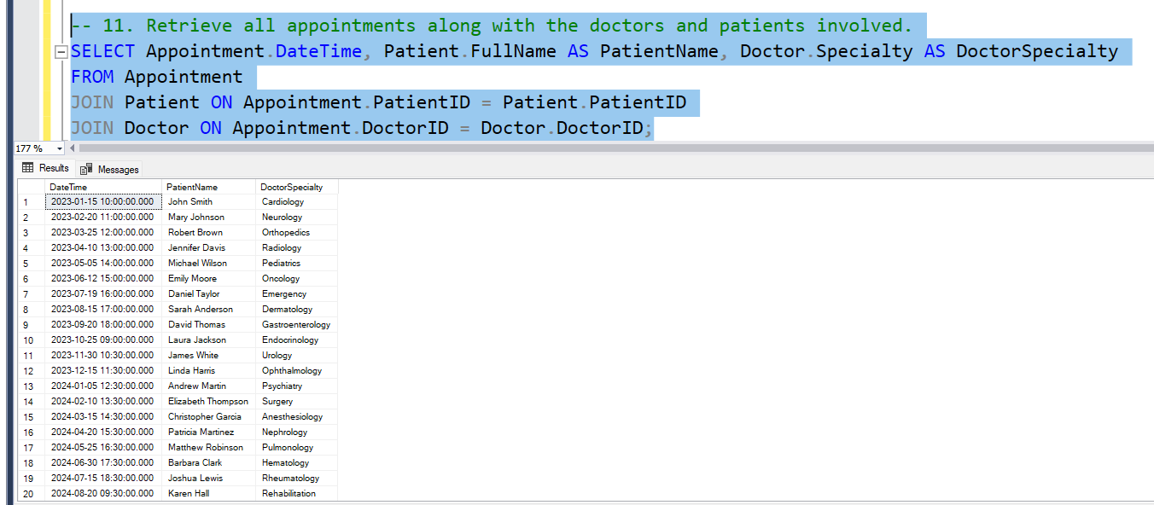
11. Retrieve all appointments along with the doctors and patients involved.
oFunction: Shows the time of appointments, patient names, and doctor specialties.
oPurpose: Visualizes appointment participants and schedules.

Slide 22
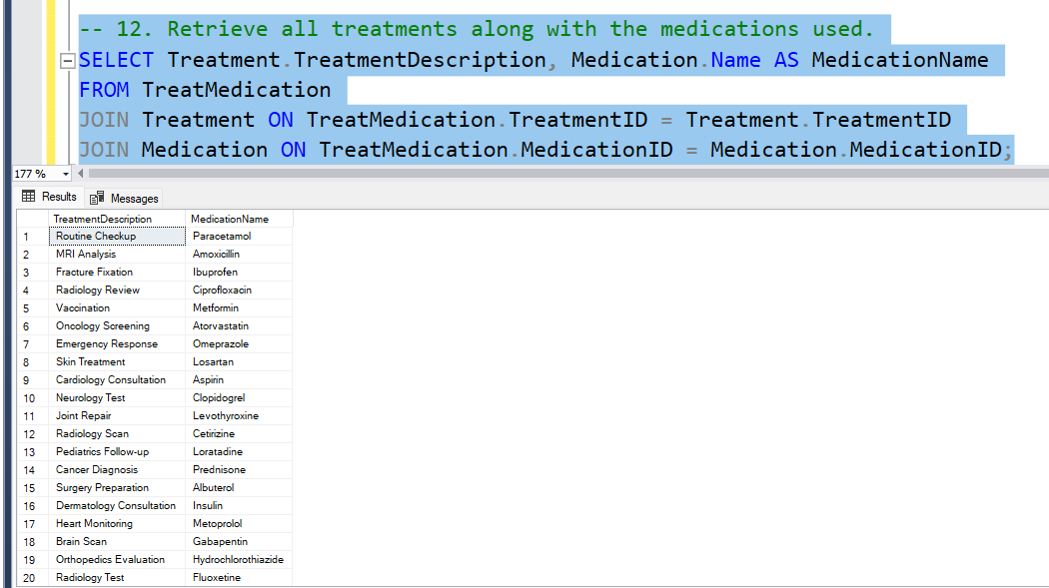
12. Retriee all treatmenvts along with the medications used.
oFunction: Lists treatments with the medications used for each treatment.
oPurpose: Tracks the relationship between treatments and medications.

Slide 23
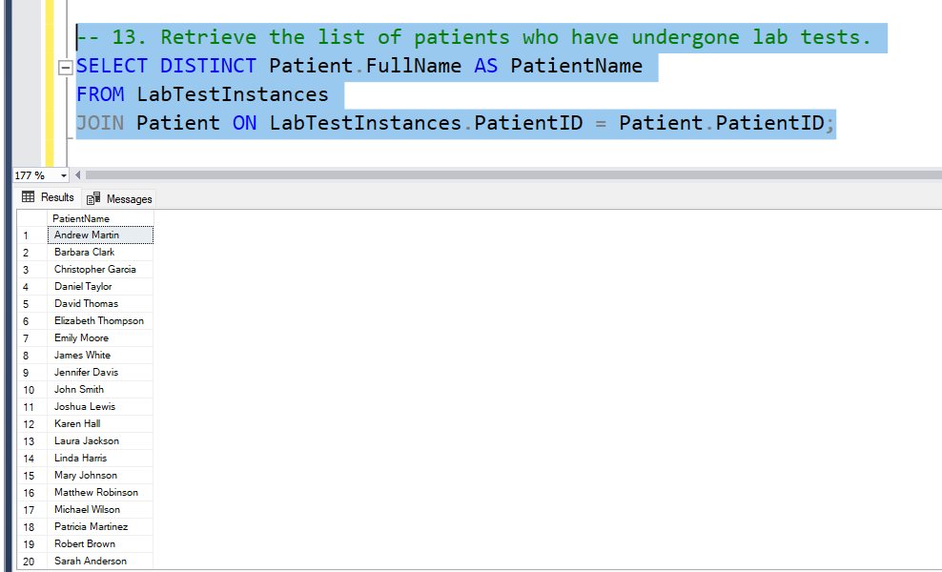
13.Retrieve the list of patients who have undergone lab tests.
oFunction: Displays a unique list of patients who have completed lab tests.
oPurpose: Understands the coverage of lab testing among patients.

Slide 24
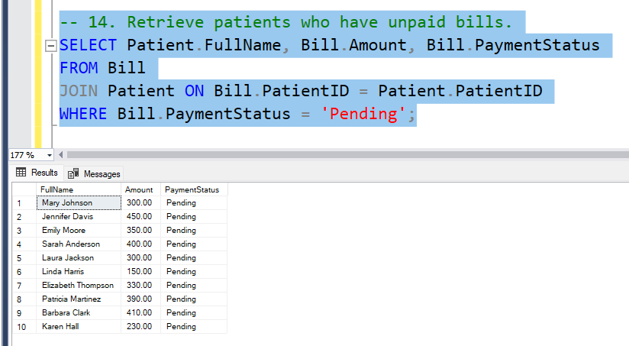
14. Retrieve patients who have unpaid bills.
oFunction: Lists patients with unpaid bills, including the bill amount and status.
oPurpose: Identifies overdue payments for follow-up.

Slide 25
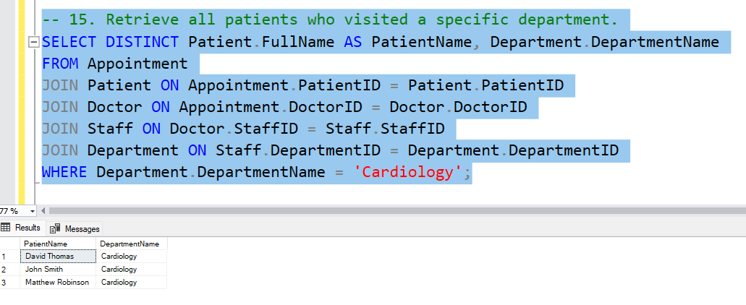
15.Retrieve all patients who visited a specific department.
oFunction: Lists patients who visited a specific department (e.g., Cardiology).
oPurpose: Tracks patient volume for a specific department.

Slide 26
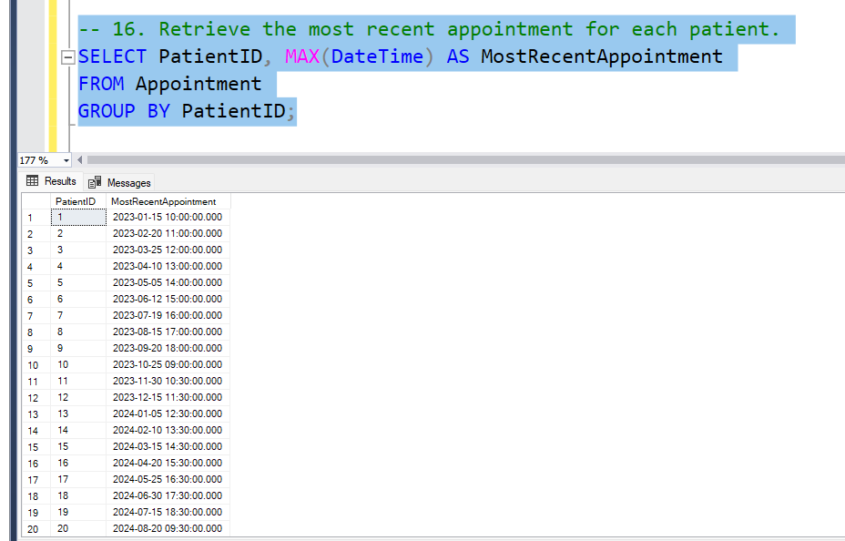
16. Retrieve the most recent appointment for each patient.
oFunction: Displays the most recent appointment time for each patient.
oPurpose: Tracks the latest interactions for each patient.

Slide 27
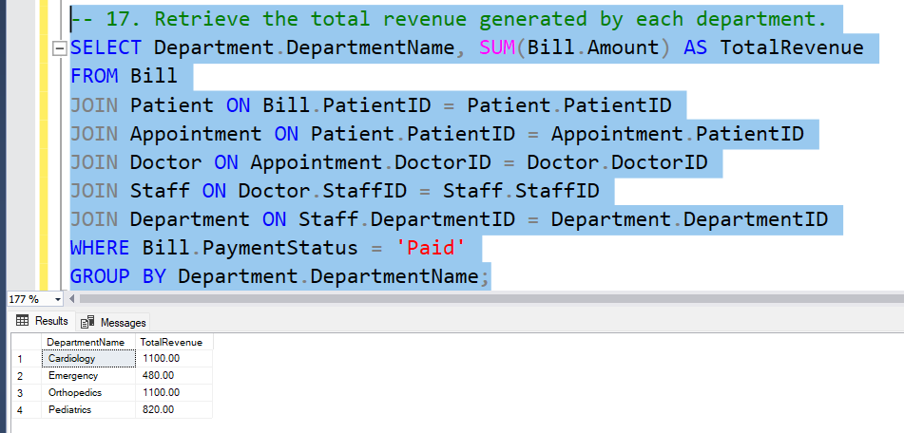
17. Retrieve the total revenue generated by each department.
oFunction: Calculates the total revenue for each department based on paid bills.
oPurpose: Evaluates the financial contribution of each department.

Slide 28
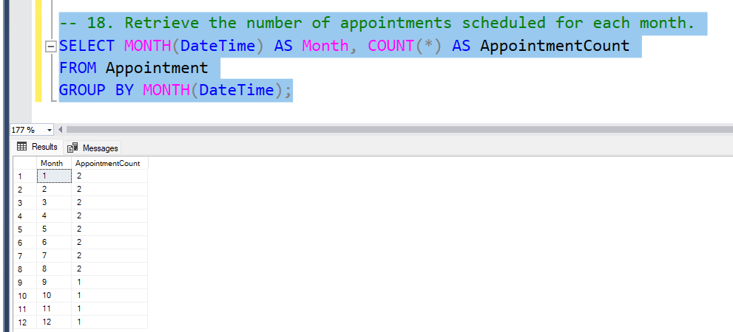
18. Retrieve the number of appointments scheduled for each month.
oFunction: Counts the number of appointments grouped by month.
oPurpose: Analyzes monthly trends in appointment scheduling.

Slide 29
3.User Manual for Hospital Management System
Introduction
This application is a simple Hospital Management System designed for managing patient data efficiently. It provides a graphical user interface (GUI) for performing basic database operations such as adding, updating, deleting, and viewing patient records
Main Features
Add Patient: Add a new patient record to the database.
Update Contact: Update the contact details (phone number and email) of an existing patient.
Delete Patient: Delete a patient record from the database.
View Patients: View all patient records or search for a specific patient by ID.

Slide 30
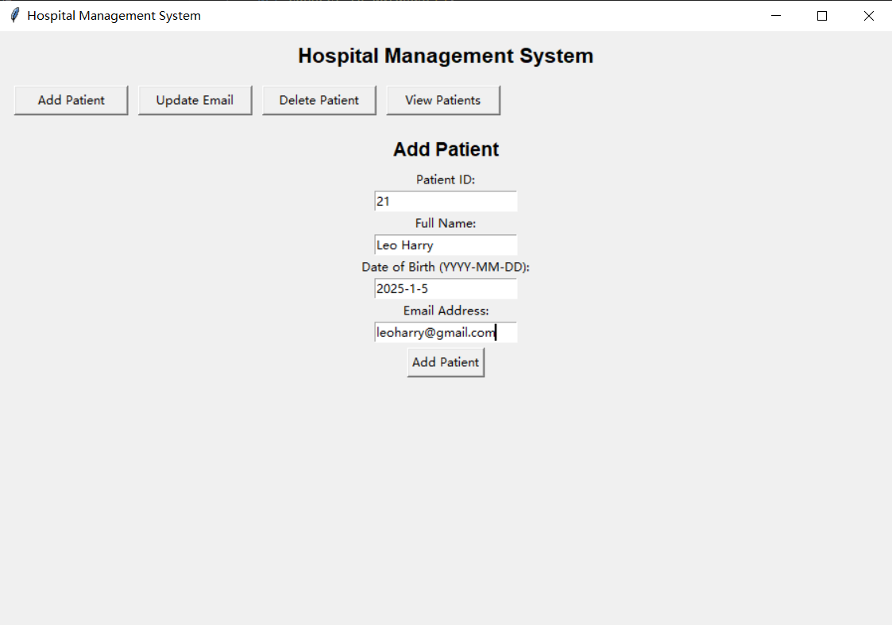
1. Add Patient
Steps to Add a Patient:
Click on the "Add Patient" button at the top of the screen.
Fill in the required details in the form:
Patient ID: A unique identifier for the patient.
Full Name: The full name of the patient.
Date of Birth: Enter the date in YYYY-MM-DD format.
Email Address: Enter the patient's email address.
Click the "Add Patient" button below the textboxes to save the record.
If successful, a confirmation message will appear.

Slide 31
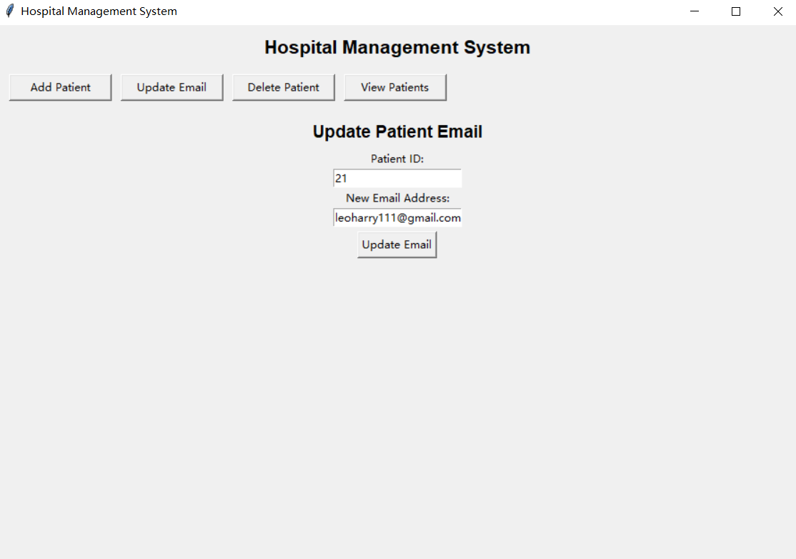
2. Update Email
Steps to Update a Patient's Email:
Click on the "Update Email" button at the top of the screen.
Enter the following details:
Patient ID: The ID of the patient whose contact details need to be updated.
New Email Address: Enter the updated email address.
Click the "Update Email" button below the textboxes.
A confirmation message will appear if the update is successful.

Slide 32
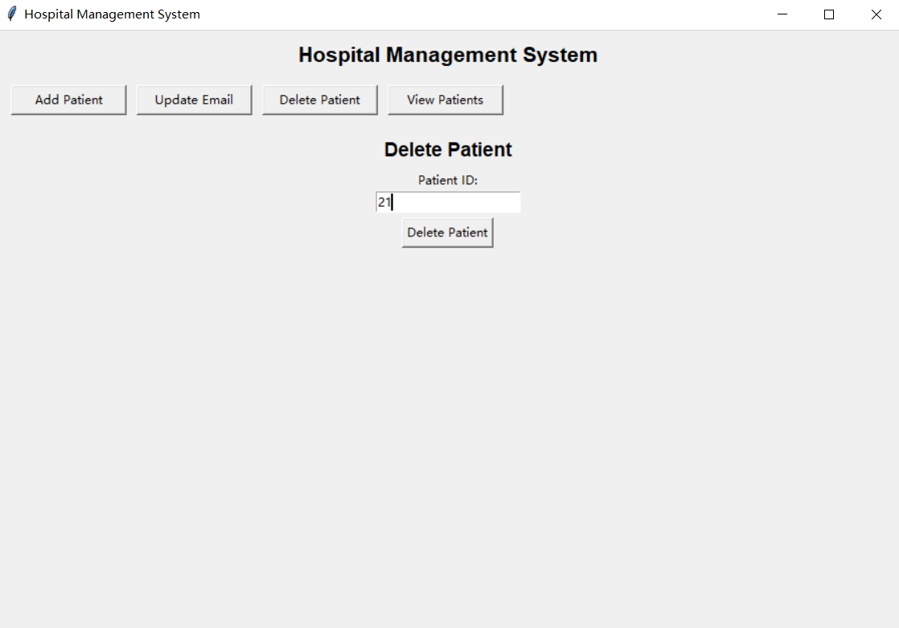
3. Delete Patient
Steps to Delete a Patient:
Click on the "Delete Patient" button at the top of the screen.
Enter the Patient ID of the record to be deleted.
Click the "Delete Patient" button below the textbox.
A confirmation message will appear if the deletion is successful.

Slide 33
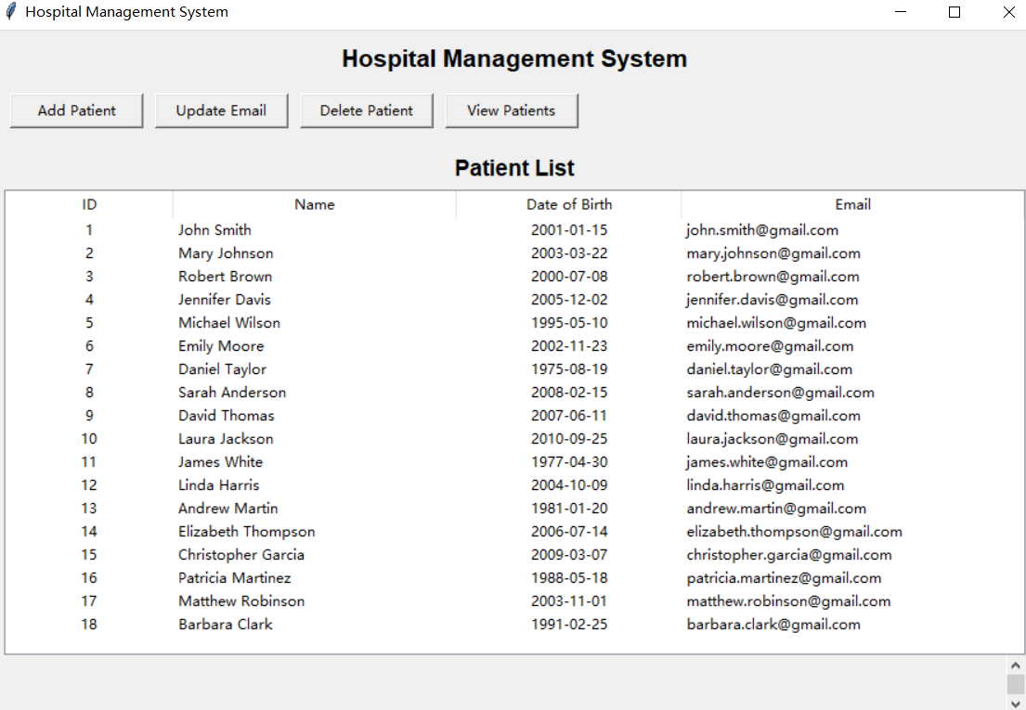
4. View Patients
Steps to View All Patients
Steps to View All Patients:
Leave the textbox blank and click on the "View Patients" button below the textbox.
All patient records will be displayed in a table format.
Each record includes:
ID: Patient ID
Name: Patient's Name
Date of Birth: Patient's Date of Birth
Email: Patient's Email Address

Slide 34
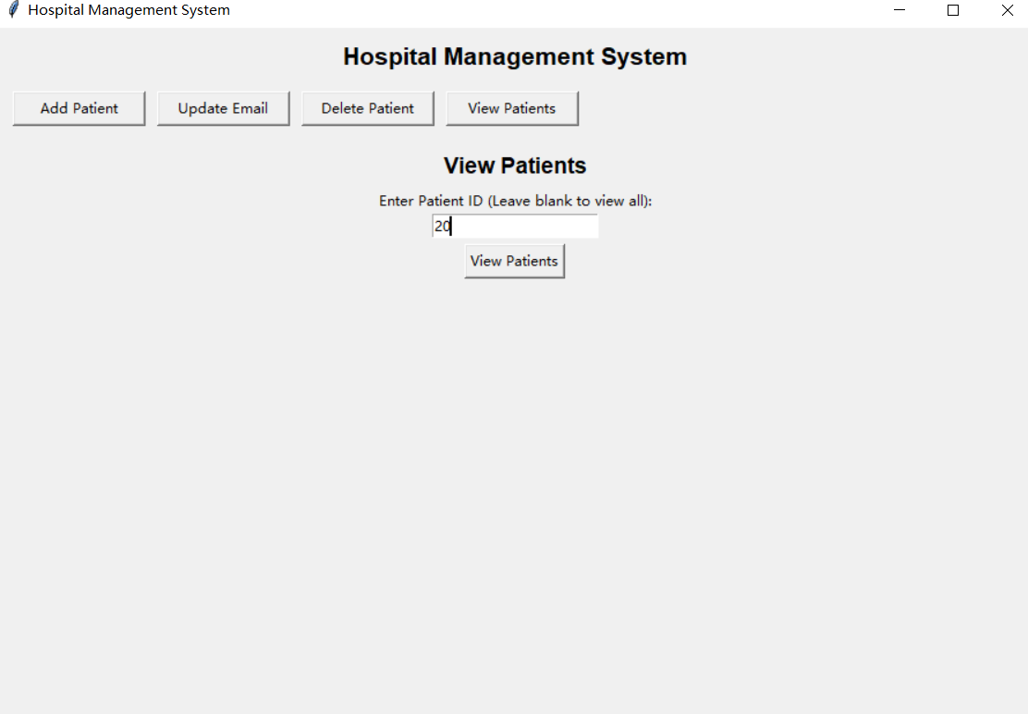
Steps to Search for a Specific Patient
Enter the Patient ID in the search field.
Click the "View Patients" button.
The record of the specific patient will be displayed

Slide 35
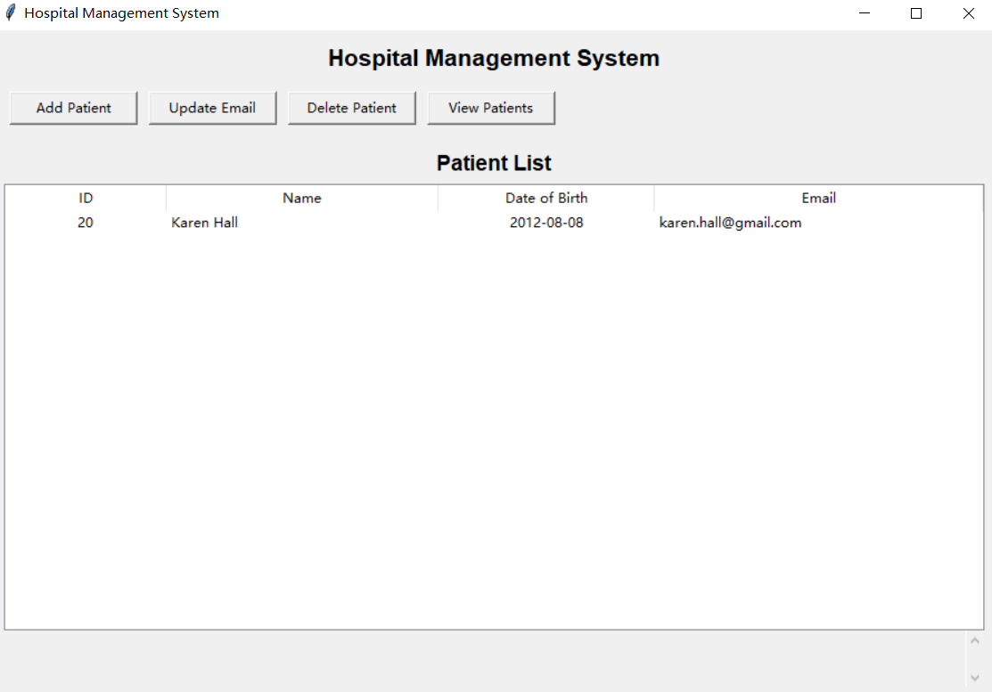

Slide 36
THANK YOU THAT’S ALL

